Slide 1
Support Vector Machines

Slide 2
Support Vector Machine
Supervised learning technique
Used for classification as well as regression
SVM as a classification method is used to predict the class of an unkown datapoint

Slide 3
Separating Hyperplane
women
men
weight
height

Slide 4
Goal of SVM
women
men
Misclassify three points of women class.
Choosing hyperplane close to one class, not generalize well.
Select an hyperplane as far as possible from each classes.
Goal: find optimal separating hyperplane which maximizes the margin of the training data.
weight
height

Slide 5
Margin and Optimal Hyperplane
women
men
Margin is the perpendicular distance between the closest datapoints and the hyperplane on both sides.
The best optimal line (hyperplane) with maximum margin is termed as Margin Maximal Hyperplane.
There will never be any datapoint inside the margin.
weight
Margin
height

Slide 6


Margin and Optimal Hyperplane
women
men
The closest point where the margin distance is calculated are considered called as Support Vectors.
weight
Margin
Support vectors
height

Slide 7
SVM Formulation

Slide 8
Setting Up the Optimization Problem
Width of margin =
So, the problem is
k
Support vectors
w

Slide 9
Setting Up the Optimization Problem
Scaling w, b so that k =1, the problem becomes:
So, the problem is
K=1
Support vectors
w

Slide 10
Setting Up the Optimization Problem
If class 1 corresponds to 1 and class 2 corresponds to -1, we can rewrite:
As
So the problem becomes:
or

Slide 11
Linear SVM Formulation
Find w, b that solve:
Quadratic problem, problem is convex unique global minimum value

Slide 12
Dual Formulation
Find w, b that solve:
Dual formulation of linear SVM

Slide 13
Dual Formulation
The previous problem can be rewritten as:
where N is the number of samples
Then w can be defined as :
So the solution becomes:

Slide 14
Non-Linear SVM Classification

Slide 15
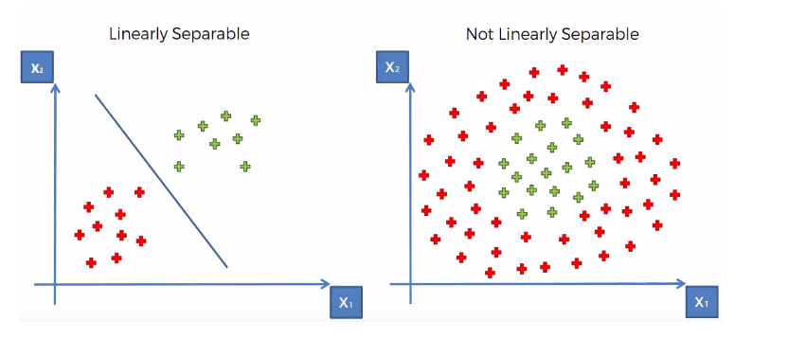
Non-Linear Classification

Slide 16
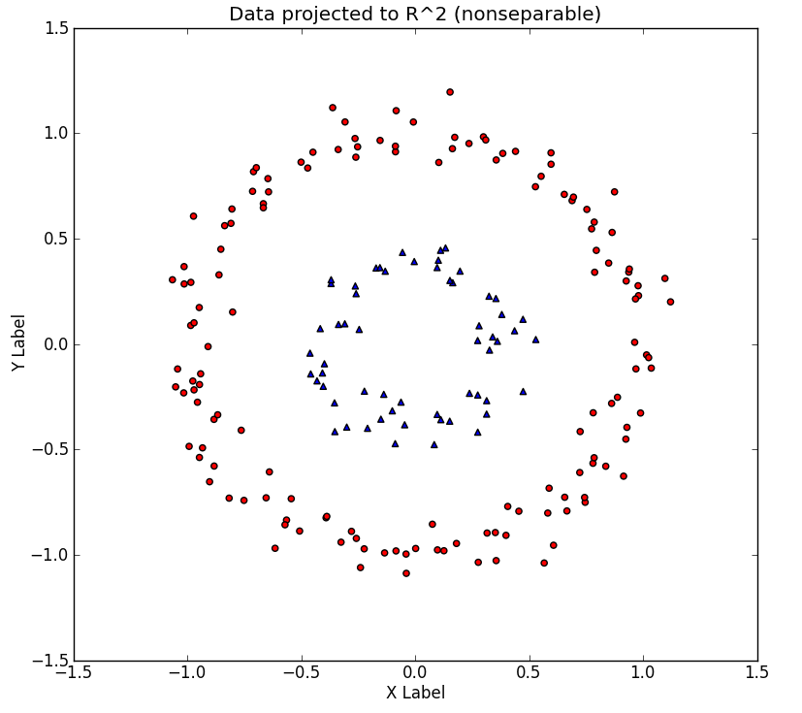
Non-Linear Classification
Consider the non-linear dataset, with its two concentric rings. Imagine that this dataset is merely a 2-D version of the 'true' dataset that lives in a 3-D space

Slide 17
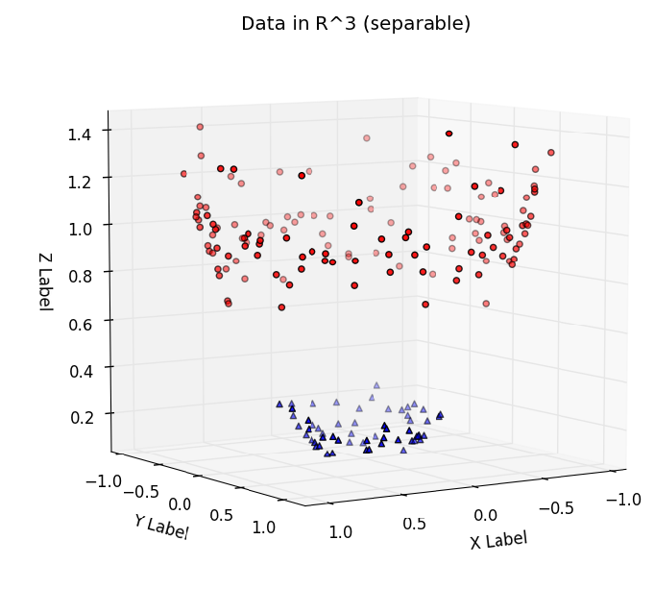
Non-Linear Classification
The dataset is easily linearly separable by a hyperplane. Thus, provided that we work in this space, we can train a linear SVM classifier that successfully finds a good decision boundary.
The challenge is to find a transformation 2D->3D, such that the transformed dataset is linearly separable.

Slide 18
Modified SVM
Assume: we have such a transformation Φ, the modified SVM classification is as follows:
First transform the training set X to X’ using Φ
Train a linear SVM on X’ to get the classifier f_{svm}
For testing , the new example x will first be tansformed to x ’ = Φ ( x )
Apply f_{svm} (x ’) to determine the output class label

Slide 19
The Kernel Trick
Kernel Trick maps the non-linearly separable data to higher-dimensional space using some kernel functions so as to make it linearly separable.
Kernel function K(x,y), is a mapping such that
that is the dot product of input x and y, transformed by a function Φ
Works on the inner product of the vectors

Slide 20
Kernel Functions

Slide 21
Examples of Kernel
Assume we have input vectors x and y, we use the kernel mapping:
Consider the function:

Slide 22
Examples of Kernel
Then :
Φ(x)^{t} .Φ(y)^{t} = x₁² y₁² + x₂² y₂² + 2 x₁x₂y₁y₂ + 2 x₁y₁ + 2 x₂y₂ +1
= (x₁ y₁ + x₂y₂ + 1)²
= (x.y + 1)²
= K(x,y)

Slide 23
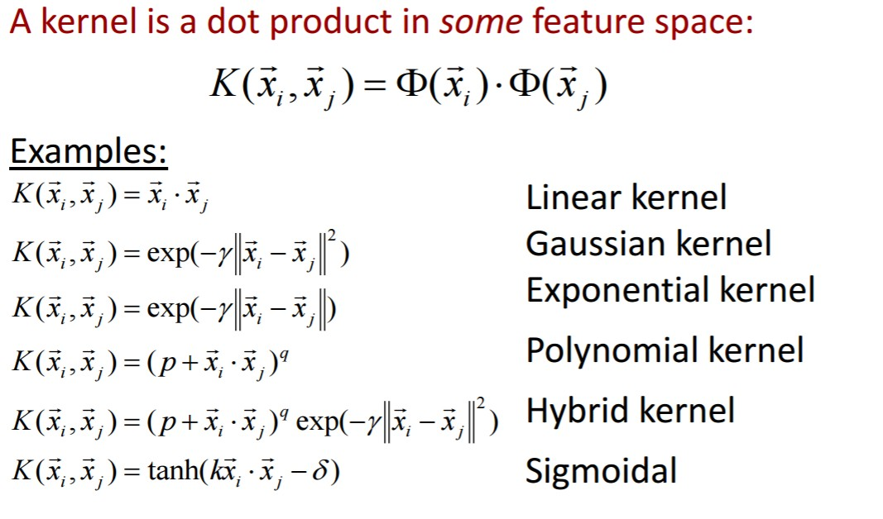
Some Popular Kernels

